Slide 1
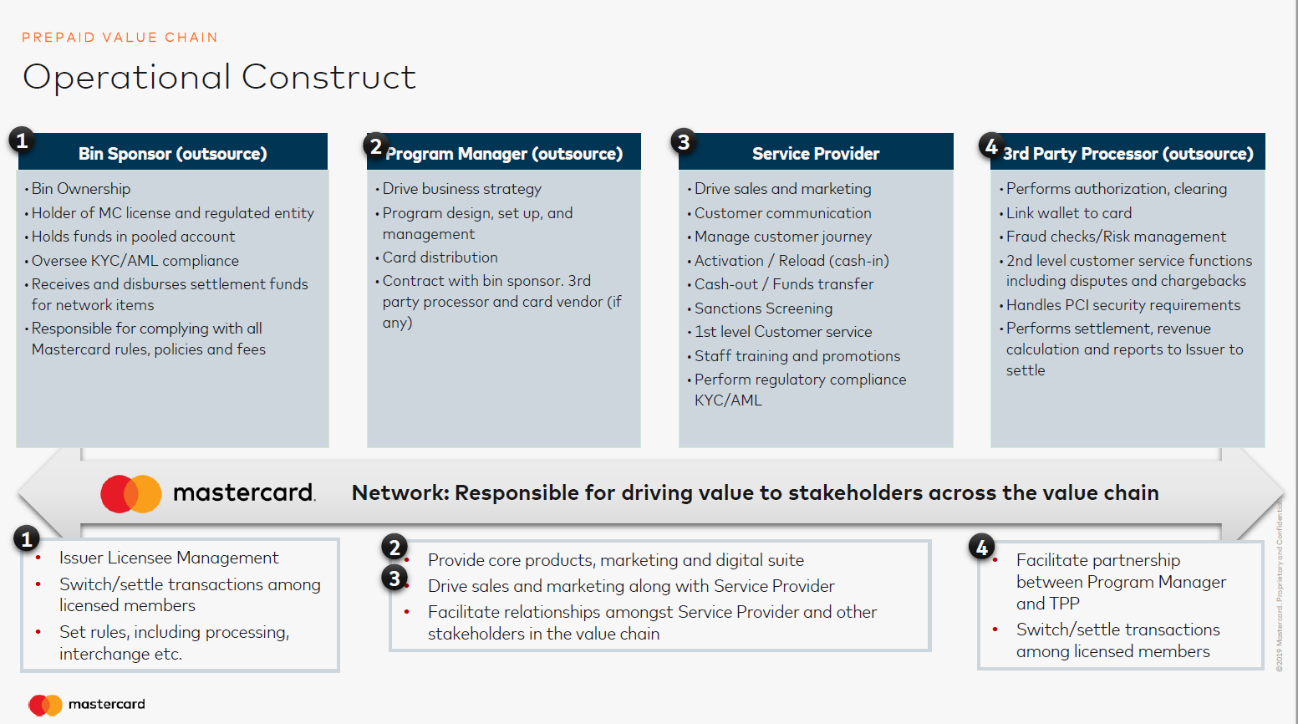
Network: Responsible for driving value to stakeholders across the value chain

Slide 2
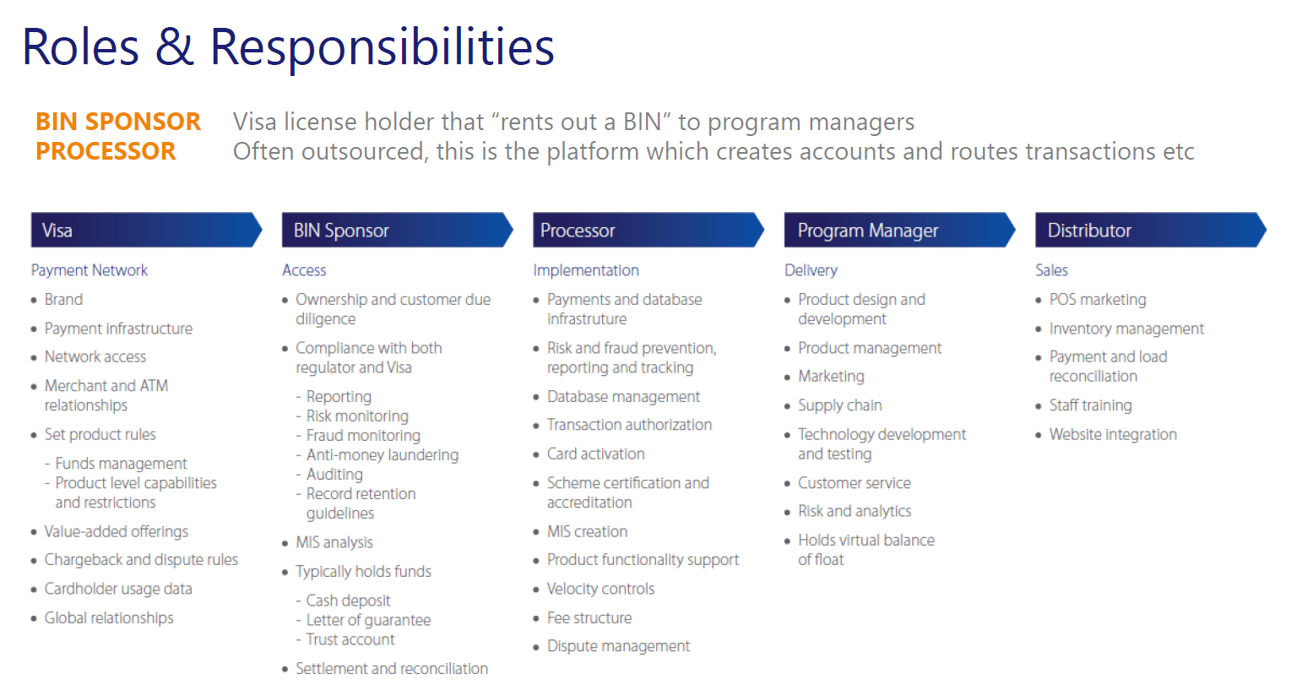
Card Scheme

